Slide 1

Intern project
An ecommerce online clothing store

Slide 2
SITE TECHNOLOGIES
HTML and CSS (Frontend)
PHP (Full-Stack)
WORDPRESS (Backend)
WOOCOMMERCE (Backend)
MYSQL (Database)

Slide 3
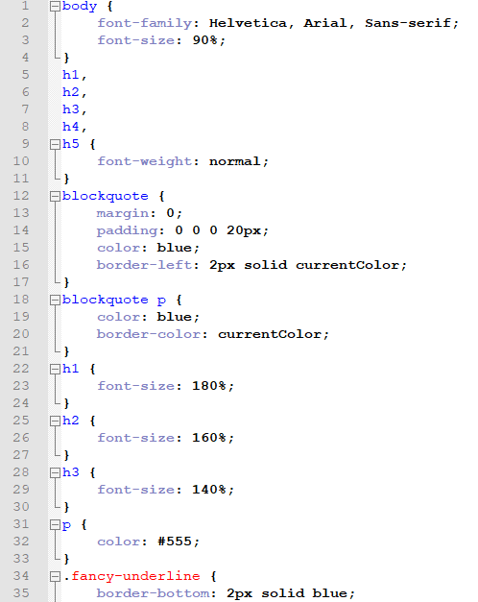
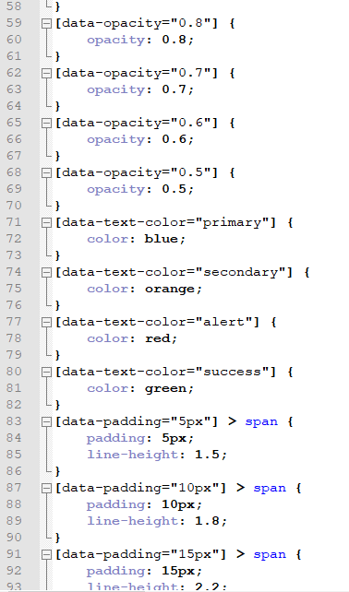
FrontEnd – HTML, CSS
CSS (Cascading Style Sheet) – mechanism to add style to web documents (HTML).
Outer-brackets are the classes and IDs of HTML and the inner bracket codes are the definitions of styles.

Slide 4
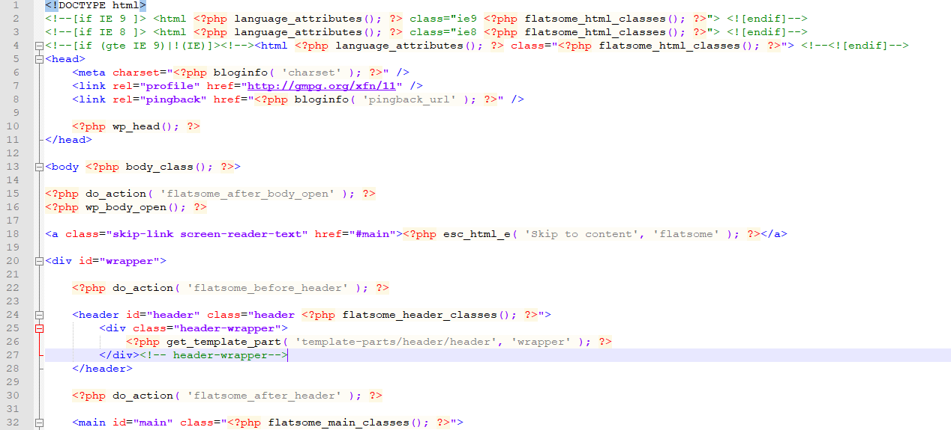
PHP – the Full Stack language
HEADER – online store page
This code consists the HEADER portion of the Online Store.
It is a mixture of HTML and PHP but raw PHP is its base.
The <head> // codes // </head> portion defines and includes the required configurations like stylesheet, functions, scripts etc. It is the main part of web pages, even though nothing is visible in the website about headers.
The <body> // codes </body> portion is the portion that is displayed on websites. Anything that is written over here is displayed on webpages.

Slide 5
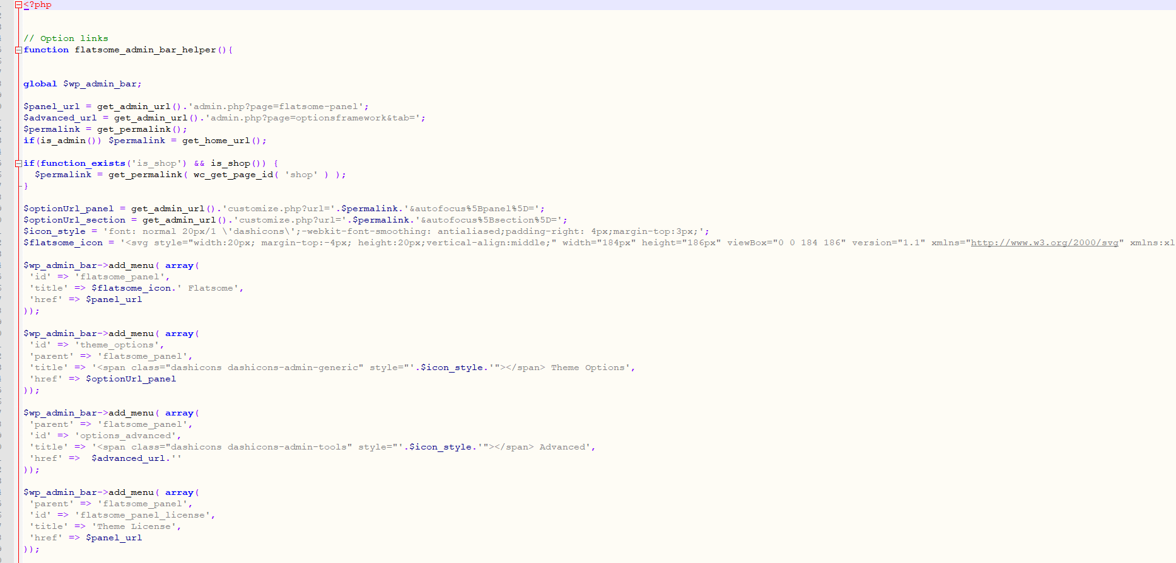
PHP – the Full Stack language
Admin bar – online store page
This code consists the ADMIN-BAR portion of the Online Store.
Mainly, there are queries in this page.
$panel_url -> $ sign represent variable in php code.
get_admin_url(); -> this is the function where link for the admin is to be fetched.
There are arrays to include data that is to be fetched between front-end and back-end supported by MySQL database.

Slide 6
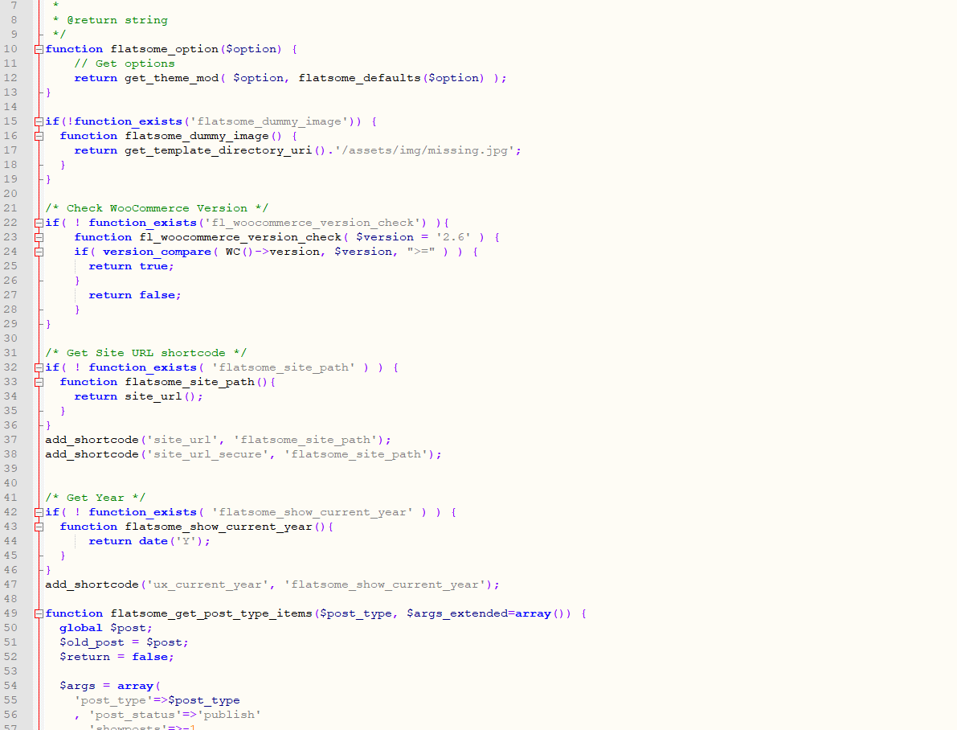
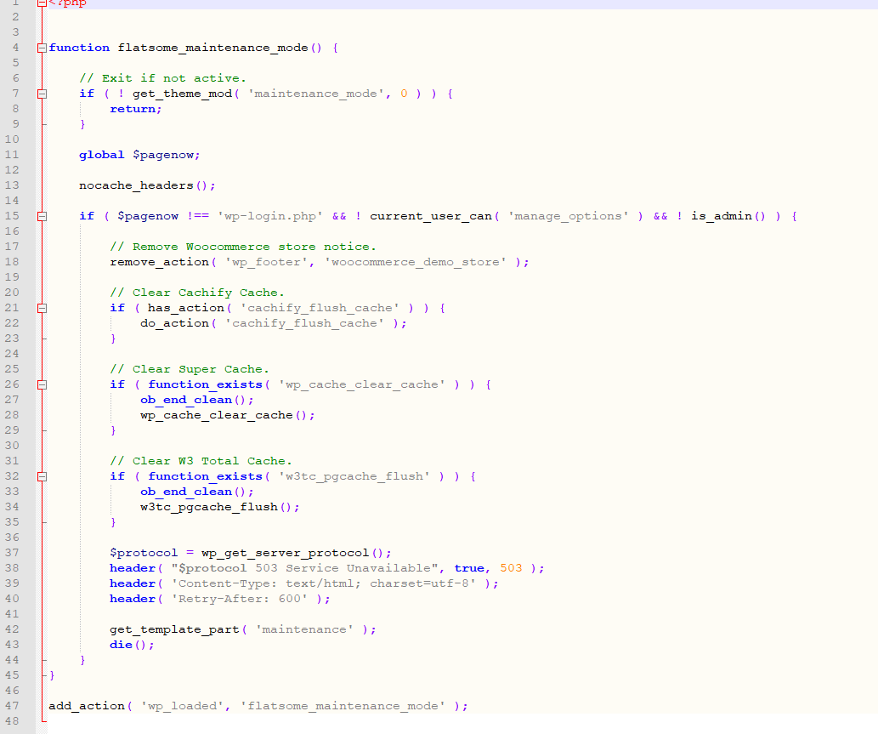
PHP – the Full Stack language
Functions – for global usage
Functions – for maintenance
This code consists the FUNCTIONS where the data is to be processed.
Functions – for global usage are the functions that are being used globally across the whole site. It mainly represents conditional statements to show if data exists or not.
Functions – for maintenance are the functions that are being used for maintaining data. Here, it also contains conditional statements to clear or delete data or cache across the site.

Slide 7
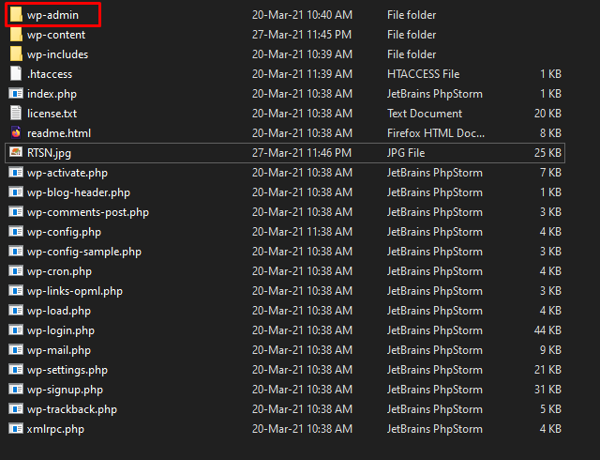
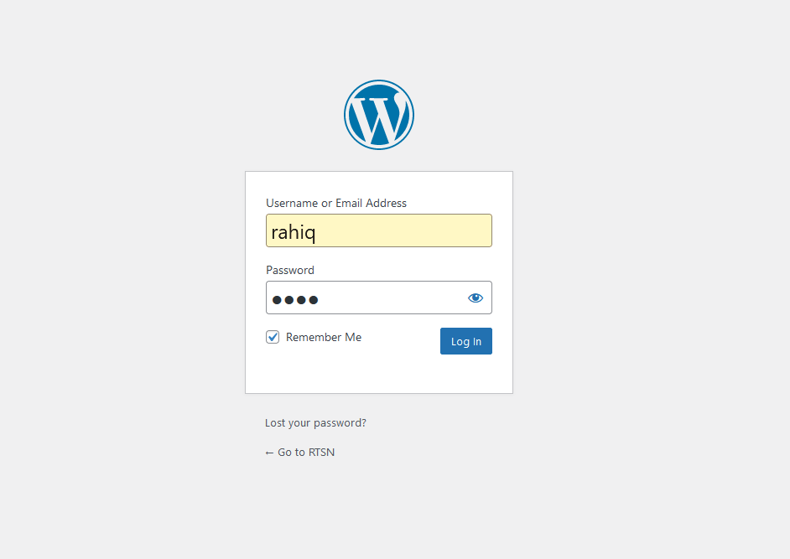
Admin Panel
wp-admin is the folder where the admin panel is located.
Admin panel is generally accessed by entering the following link:
http://localhost/internProject/wp-admin/

Slide 8
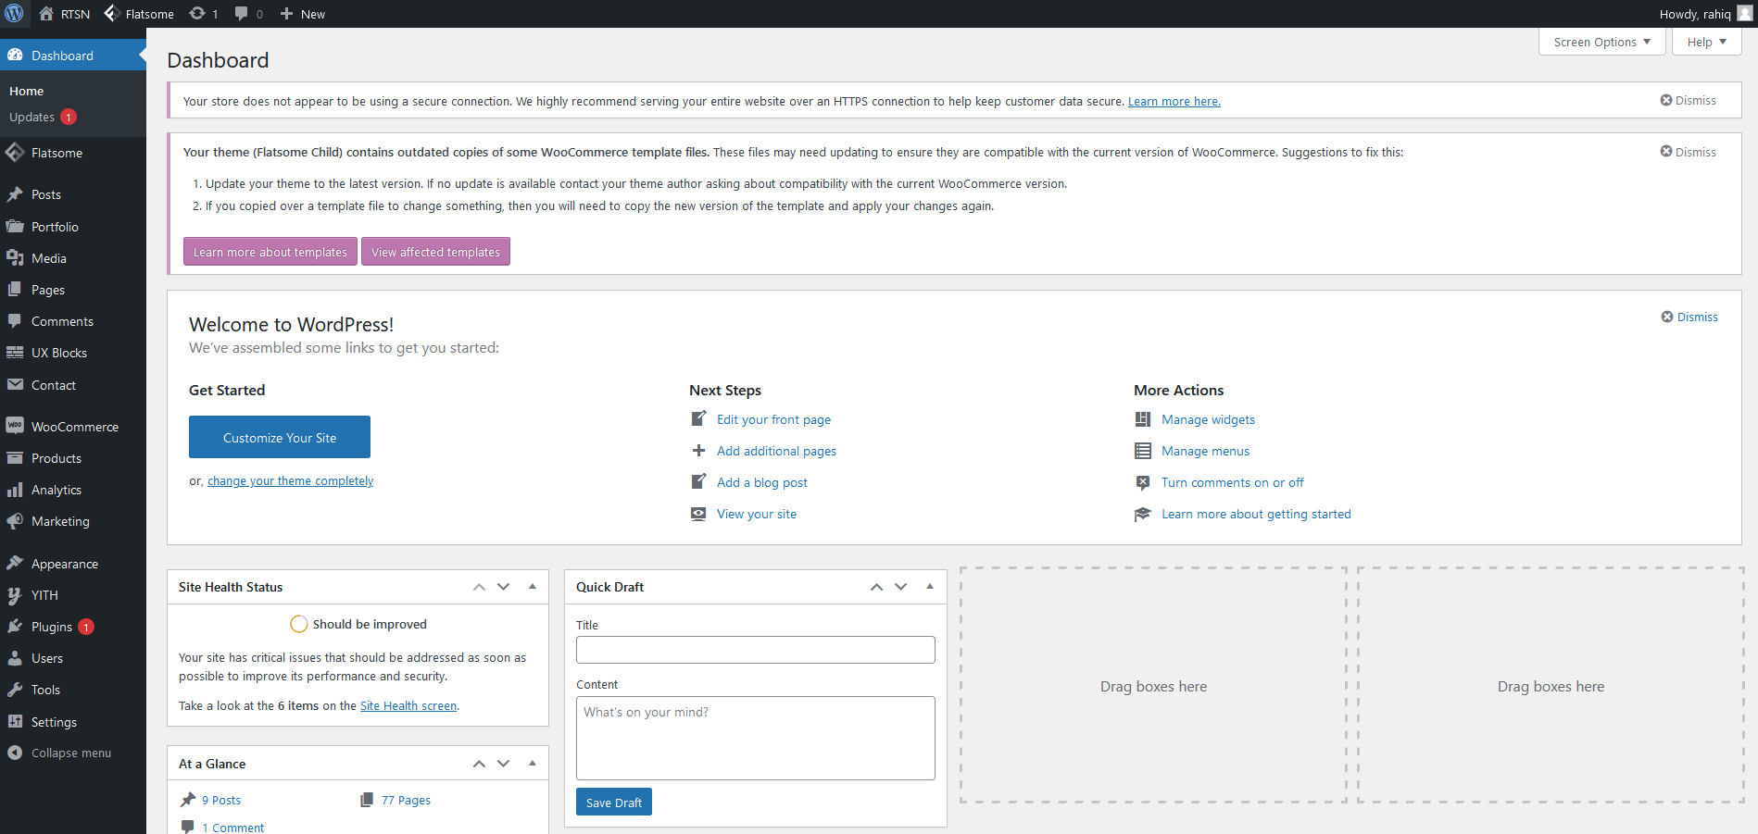
Admin Panel
This is the admin panel or dashboard for the online eCommerce Site
The dark region (left sidebar) consists all the configurations for the online store.
In this way, any non-coders can maintain the site.
Digital Marketers and other non-technical person can easily track and maintain orders, sales, items etc, the requirements for the online business.

Slide 9
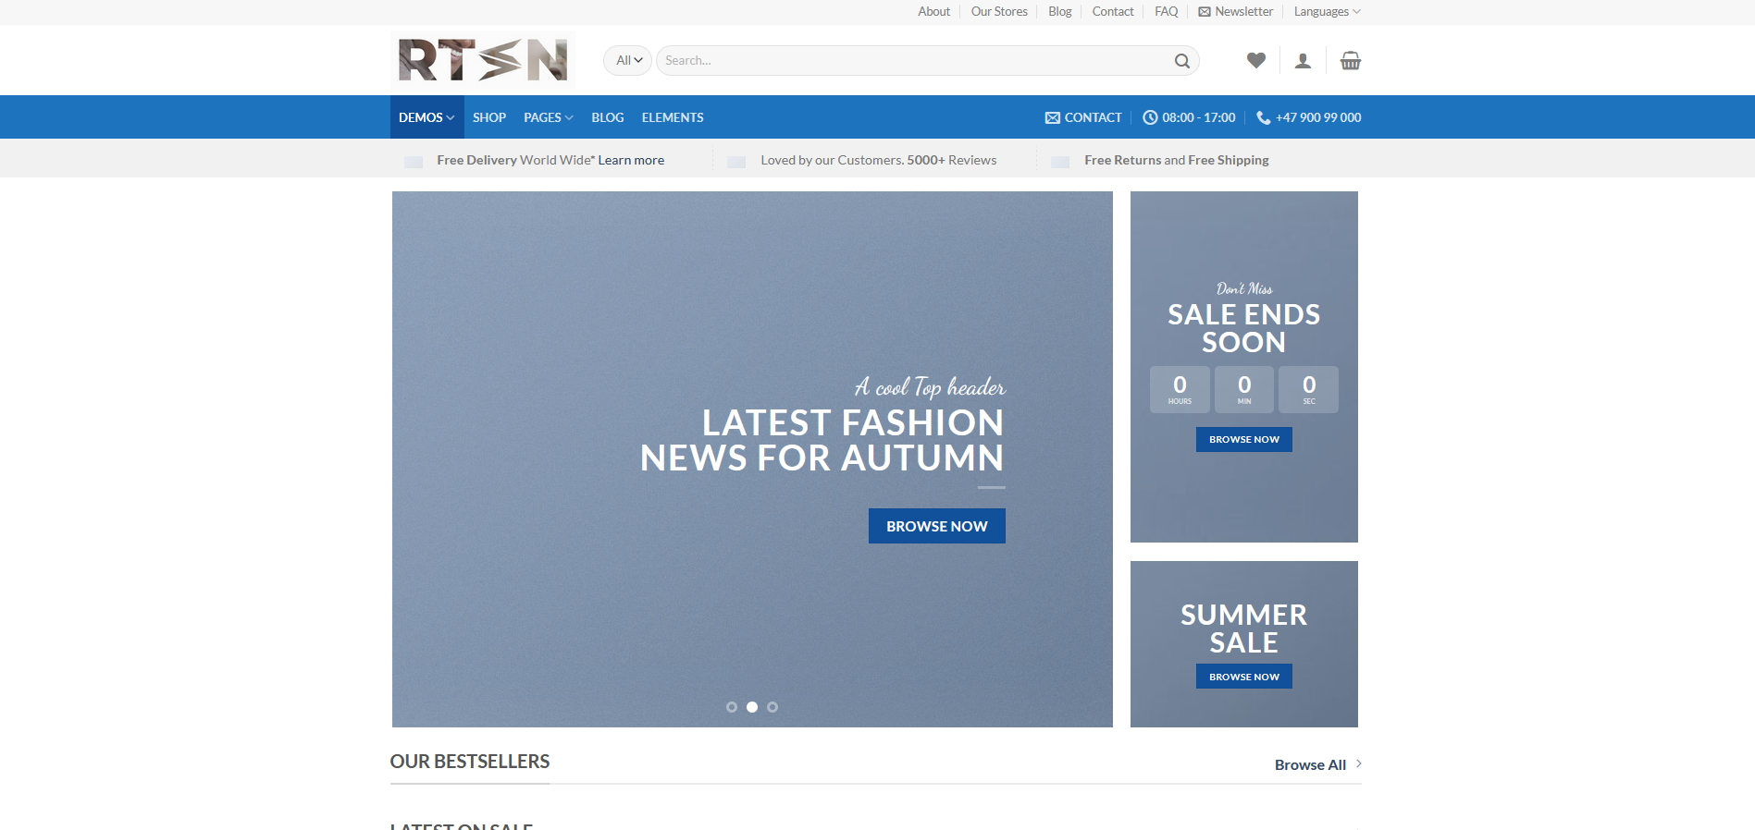
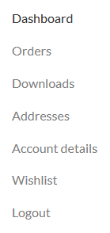
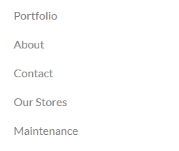

Web Page – Landing Page
This is the Landing page for the online eCommerce Site.
It contains:
Carousel: The highlighted item that is to be displayed.
Search Bar: It is one of the most prominent feature for eCommerce site.
User-Panel : It is a dropdown item list that shows the main items for a user.
Contact Info: General items that is heavily used in eCommerce sites
Pages: It contains site items like Portfolio, About, Contact, Our Stores etc.

Slide 10
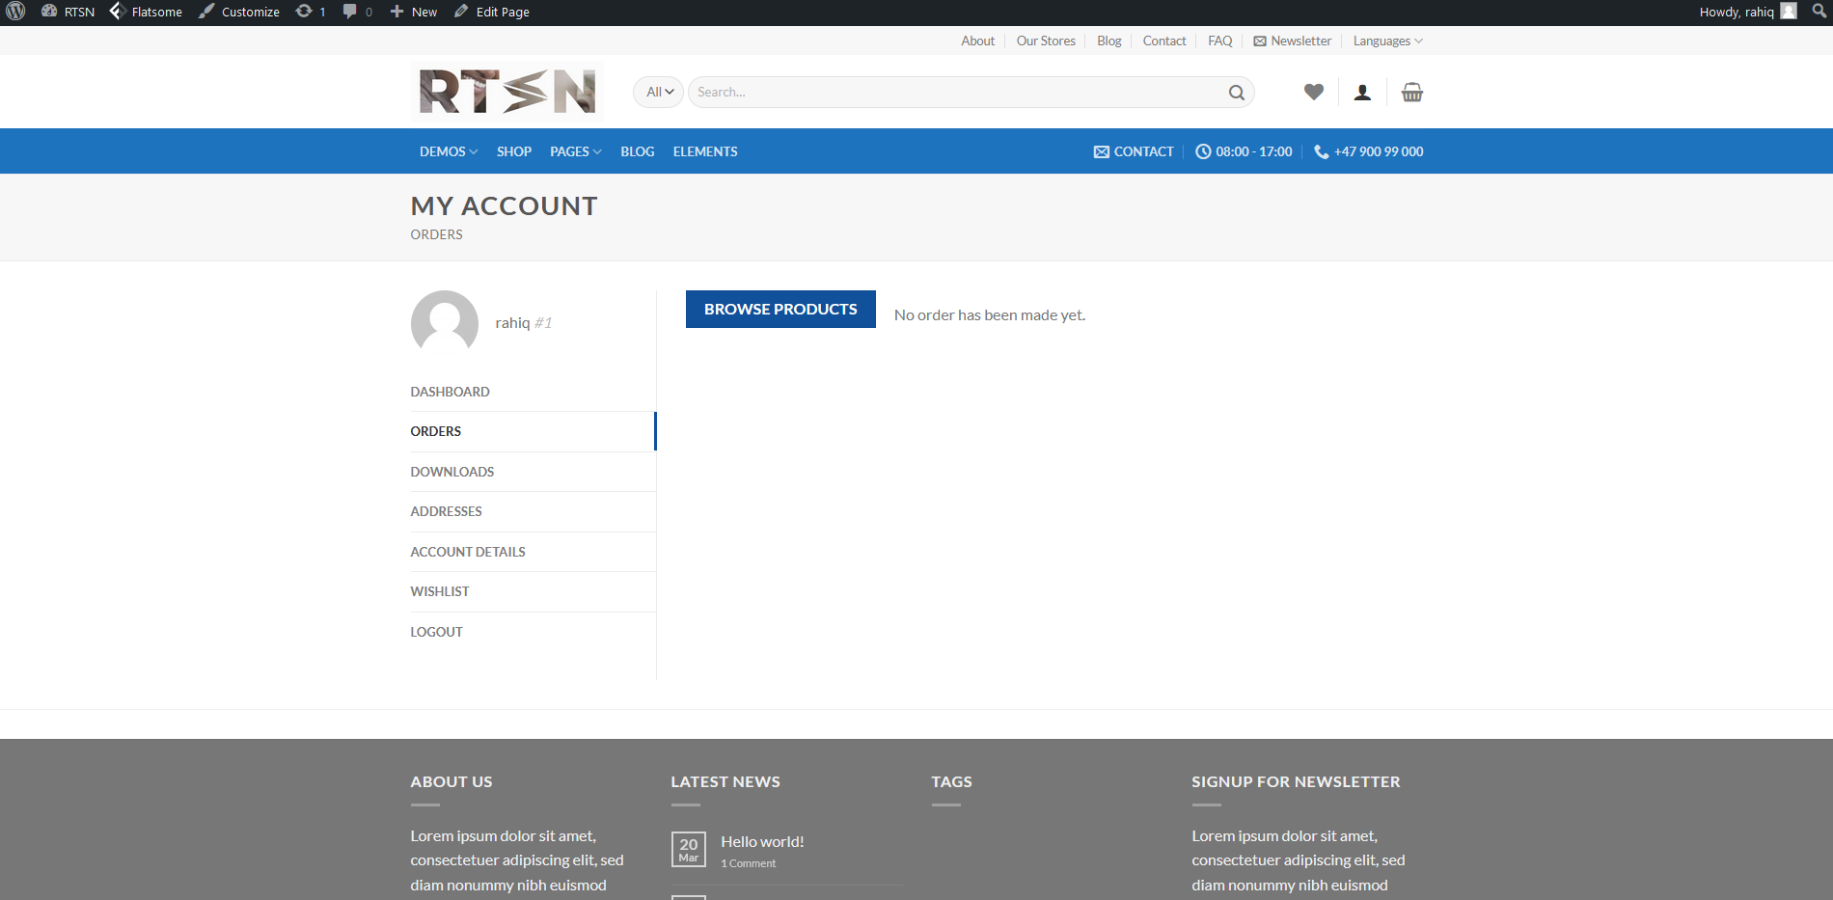
Web Page – User Account Panel
This is the User Panel for the online eCommerce Site.
It contains:
Dashboard: To show recent orders, manage shipping and billing addresses, and edit password and account details.
Orders: To show orders placed by the user.
Account Details: This will be how name will be displayed in the account section and in reviews.
Wishlist: This section contains all the wishlist or items that user wants to purchase.

Slide 11
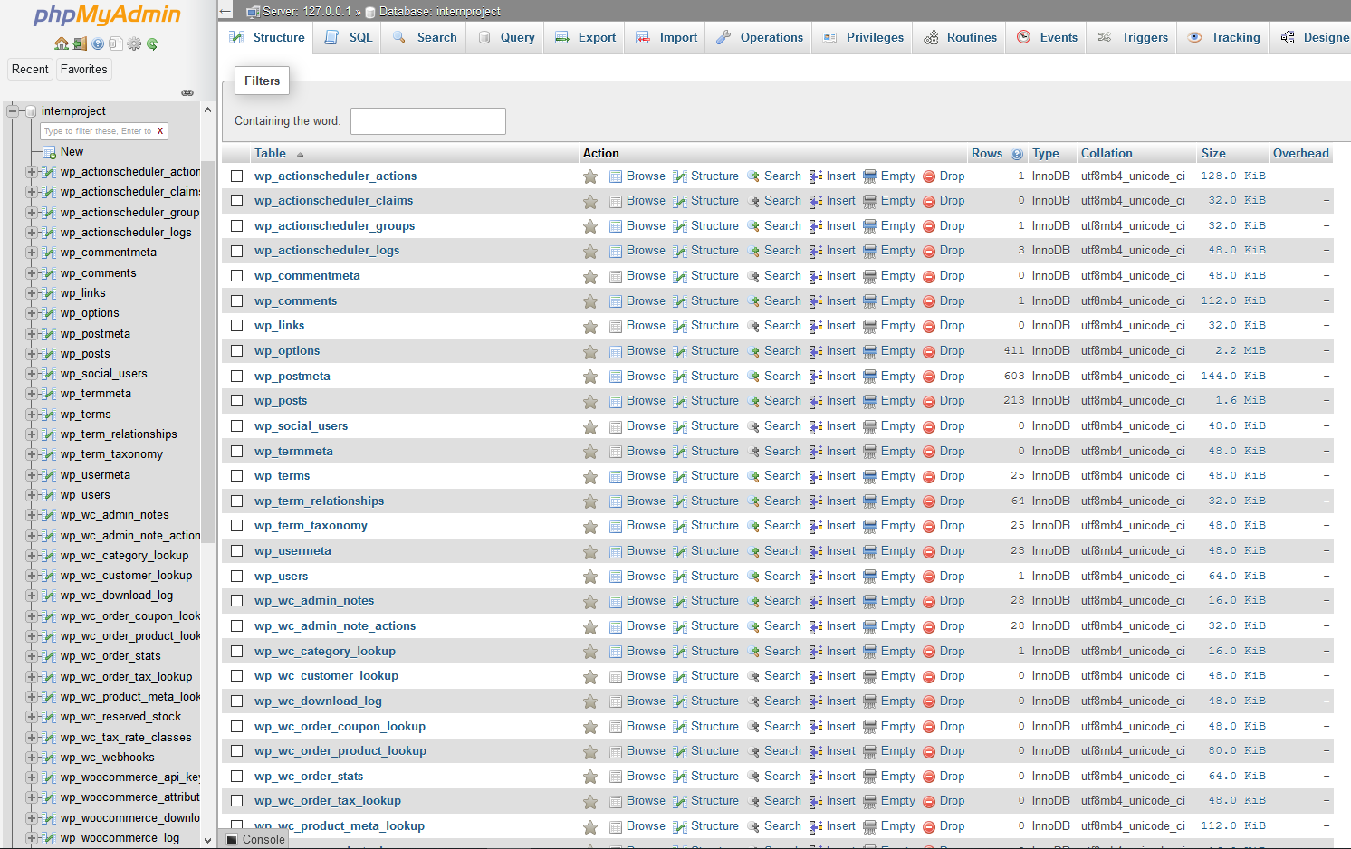
MySQL - database
This is the database page which is accessed locally through localhost/phpmyadmin (in this case)
It contains all the datas that are being used and accessed throughout the site.
It contains user data, account data, product data as well as admin data etc.
It can even store large information like posts, comments, terms and conditions etc.
It is mainly designed in MySQL.

Slide 12
THE END

